Slide 1
Biodiversity and the Health of Species
A study of four national parks

Slide 2
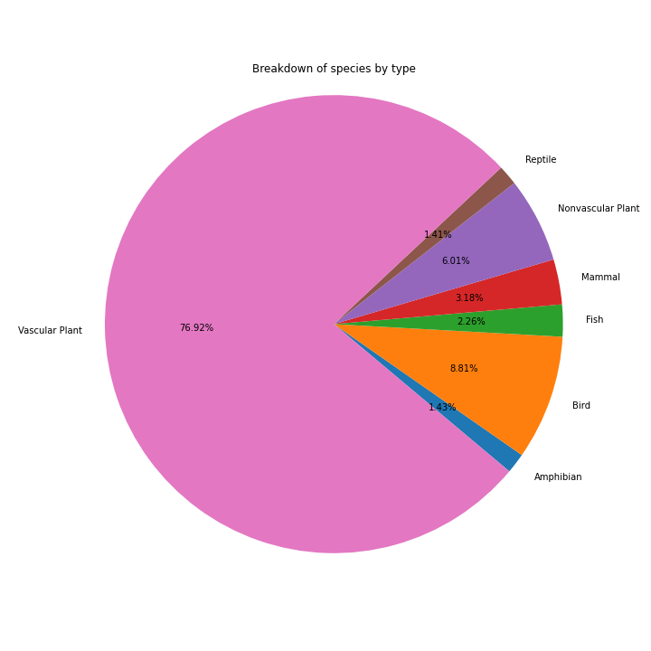
This dataset involves 5541 different species and includes information on their conservation status and taxonomical categorization.
Additionally, it tracks numbers of each species observed at four different national parks across the US.

Slide 3
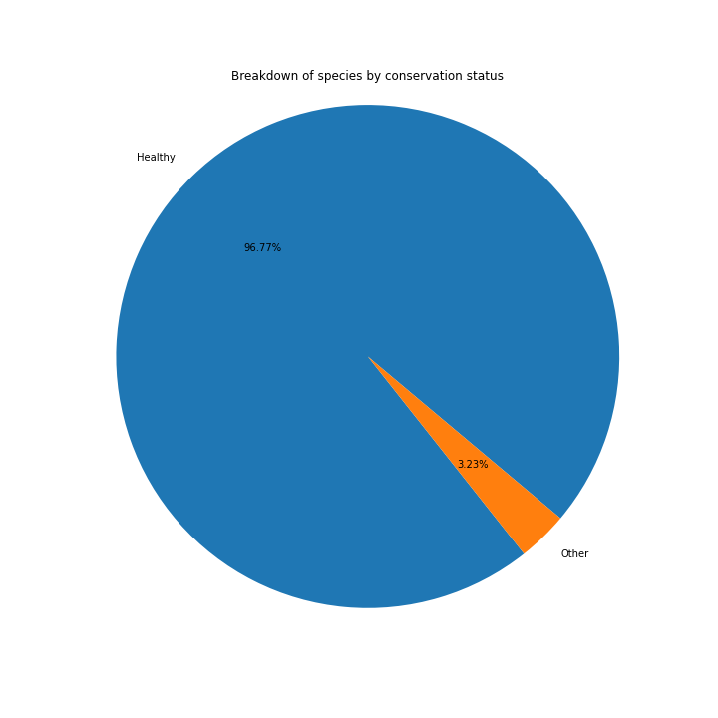
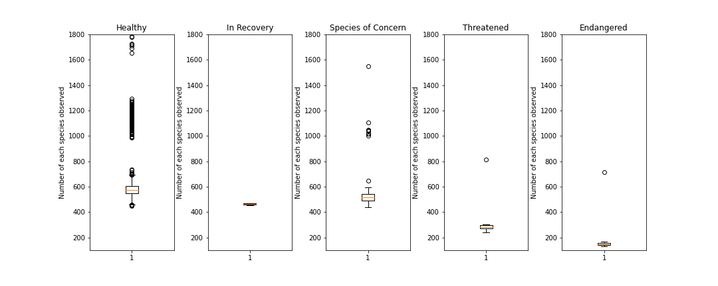
Each species is also graded by its conservation status.
Fortunately, 96.8% of the species being looked at in our survey are not considered to be at risk.
However, species at risk do show markedly lower populations than healthier species.
The mean population size for healthy species and species of concern are in the 600s, while it drops to 300 for threatened species and 175 for species of concern.

Slide 4
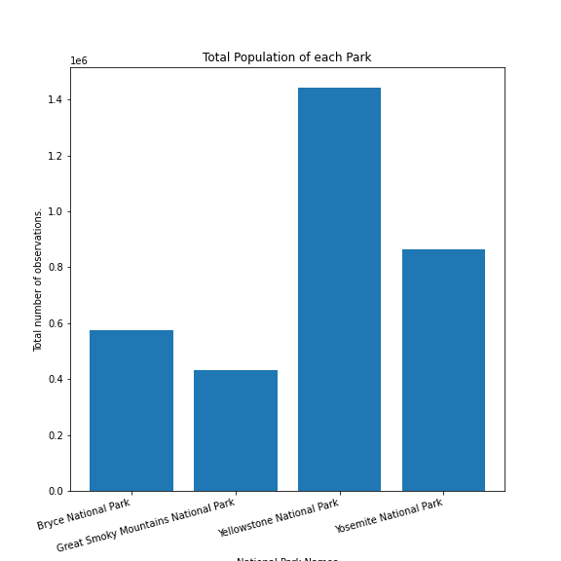
Yellowstone has more animals in this survey than any two other parks with 1.4 million.
Looking more closely, each species is present in each park, showing they all have geographical variety.
When looking at their conservations statuses, they have a smattering of notable distributions changes.
However, when looking at how they're spread out, their levels remain relatively similar across the board.
Parks therefore may have some correlation with conservation status, but it is unlikely that it is indicative of a causal relationship.

Slide 5
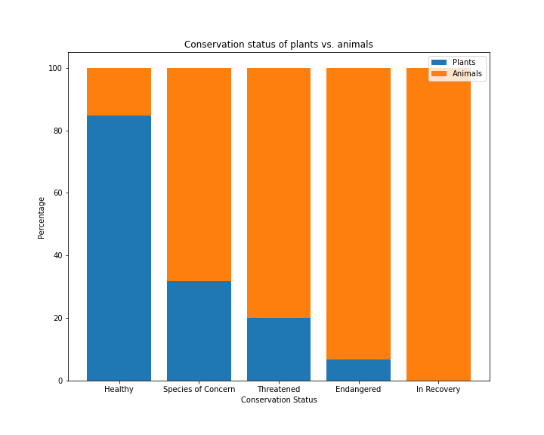
Species categorization shows several strong correlations with conservation status.
As can be seen, plants make up 84% of all healthy species
This percentage decreases sharply as the species is in more distress.
This ends in Plants making up 6.67% of all endangered species.
It is worth noting that there is more variation in the lower categories as there are 5.4k healthy species compared to a mere 179 species on the endangered spectrum.
However, this cannot compare with the drop from 84% to 31.8% for Species of Concern and only going further from there.
In addition, T-Tests show that Vascular Plants, the largest group, have significant correlation across all categories.

Slide 6
Oddities:
Only birds in In Recovery.
Also only 40 species of birds in that category.
Recommendations:
When looking at conservation status, location does not seem to be a major indicator of whether or not a species will be endangered.
Whether or not a species is a plant or an animal does seem to be a major indicator, with animals being disproportionately likely to be endangered.
However, this does not hold when looking at the different categories of animal with three categories having roughly similar numbers.
Birds and mammals stand out as outliers, and warrant further study as to what might make them more suceptable.

Slide 7
Assumptions Used:
Data came with several scientific names being used multiple times. They were assumed to be the same and condensed.
Two scientific name multiples were attached to different conservation statuses. In both cases, when they were condensed they were given the more serious category.
Observations data was given without context. As such, it was assumed that one observation equals one animal in the wild.

